Slide 1
Agenda
  The need for a factory simulation model
  Model description and illustrative example
  How the model functions under the hood
  Model infrastructure and scalability to other applications
  How to make it function on your pc (installation)

Slide 2
Nailing the dynamic of complex production systems may require the application of computer simulation modelling
More and more often our assignments require to cope with complex production systems, where many products are produced, many machines and sites are in place, the demand is seasonal, etc.
Most often the data representing the system is “big”: the bill of materials include thousands of rows, the number of products is significant, there are many interconnected machines that can work on many different products, the production routings are differentiated and include loops, etc.
There are multiple constrains to be considered: the capacity of machines is finite, the number of available blue collars is finite, the factory must be closed in some periods of the year, etc.
To cope with such systems, we often feel the need for a simulation model, that accepts the data as it is available from the IT system, and that provides a quick way to identify bottlenecks, answer what-if questions, understand complexity and logistic costs, and more
Most simulation systems on the market are rigid: lacking the flexibility needed to take in input the data as it is available; and are expensive: requiring recurring fees to be paid for long periods, even if the utilization of the tool is sporadic
For the above reasons, a framework to implement complex simulation models has been scouted and tested, and a simplified model has been coded, it will be referenced as FSM-B for “Factory Simulation Model – Basic”
The FSM-B described hereby is actually powerful and flexible enough to solve a range of real problems, and the framework employed to develop it is extraordinarily versatile, and may be applied to tackle the most complicated scenarios

Slide 3












FSM-B: The basic model is flexible and powerful enough to solve a large set of problems; furthermore, it can be easily extended
Illustration of the model flow from inputs to answers to key problems
Possible problems that can be solved with the output
Inputs to the model
First level output
Production start dates
  Analysing the spreadsheet, many questions can be answered
Bill of Materials
Work hours per item & component
Resource planning
Bottleneck identification
Machine speeds
  The model produces a spreadsheet that lists all production events
  The spreadsheet fields include, worked hours, setup hours, production schedule, delivery dates, …
Working Timetable
Product and complexity cost
Number of blue collars
Product mix optimization
Warehouses at simulation start
Many other statistics can be extracted

Slide 4
Agenda
  The need for a factory simulation model
  Model description and illustrative example
    Inputs
    Outputs
  How the model functions under the hood
  Model infrastructure and scalability to other applications
  How to make it function on your pc (installation)

Slide 5
Agenda
  The need for a factory simulation model
  Model description and illustrative example
    Inputs
    Outputs
  How the model functions under the hood
  Model infrastructure and scalability to other applications
  How to make it function on your pc (installation)

Slide 6

The bill of material describes the “composition” of products and can be implemented through a “recursive” database
A typical “bill of material” is documented with a tree structure that represent the components of a product
For example below, the product A is made of components A1 to A4; the component A1 is made of A11 and A12; and so on
Such structure is readable for humans, but it is not the best form as an input to computers
A recursive tabular form is better suited for computer analyses
Below is the same bill of material represented with a “recursive” table
(recursive means that each child is looked up in the father column recursively to identify “nephews”)
Father
Child
A11
A
A1
A1
A
A2
A
A12
These two representations are equivalent
A
A3
A2
A
A4
for instance, the components of A3 are listed here
A1
A11
A31
A1
A12
A3
A321
A3
A31
A32
A322
A3
A32
A4
A32
A321
A32
A322

Slide 7
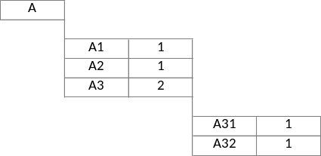
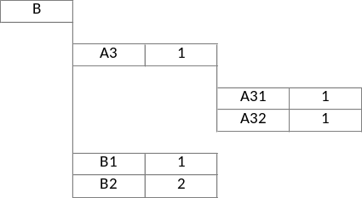
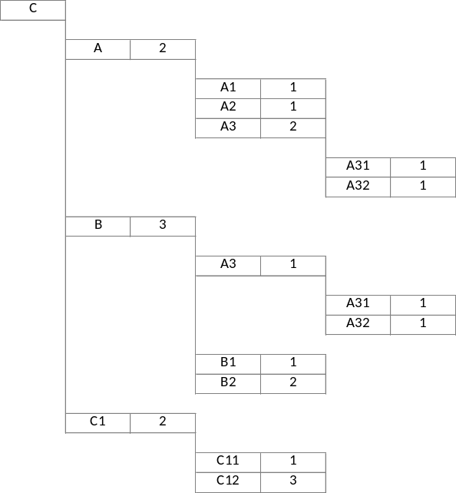
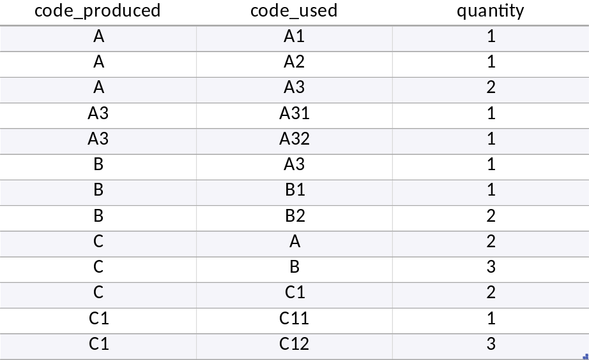
The example that will be solved is realized with the inputs illustrated hereby and in the following pages
The example simulation includes three products (the list can be much longer in the range of thousands of products)
On the left there is the hierarchical representation of the products, the numbers represent the quantity of each component needed (which can be above 1)
Below is the tabular form inserted in the simulation model input spreadsheet
The example shows that some products can be components for other products (A is a component of C)

Slide 8
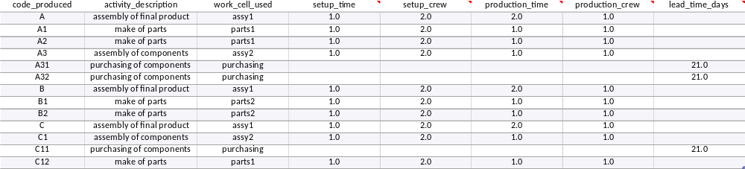
Information about the content of work, labour hours and machine hours for each product, are included in a “bill of labour” BOM table
The bill of labour table include information about how much time is employed for the fabrication of each component and product
The bill of labour may also include the purchasing cost, the learning curve parameters, and more information which for simplicity have not been included in the basic model
For each product or component, it is described the work needed
which work cell is used to fabricate or assemble or procure the code
how much time it is needed for the setup and production and how many people are needed for such operations
which is the procurement lead time

Slide 9
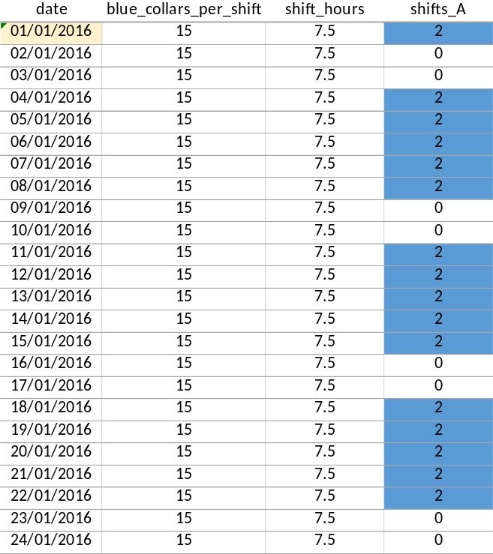
The yearly openings schedule and the available workforce is included in a file that gives the key inputs for each production day
The number of available blue collars to operate the machines in the factory is limited and can be changed during the simulation period
Also the duration of a shift and the number of open shifts can be changed during the simulation time
Multiple shifts can be designed and each machine can have a different shift schedule, (e.g. for some machine a day can have two open shifts, and another machine can have only one open shift) – the mapping of shifts to machines is reported in a separated sheet of the input excel
Vacation days are simply identified setting to zero the number of open shifts in the related date
All parameters can be changed during the simulation time and are constant only during a single day
Open hours for each shift
Number of blue collars available per shift for each date
Number of open shifts in the day

Slide 10
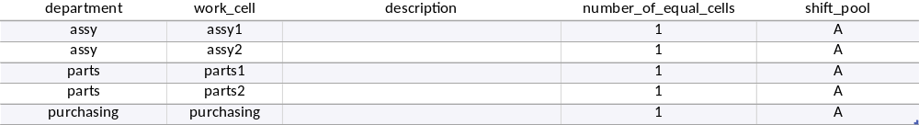
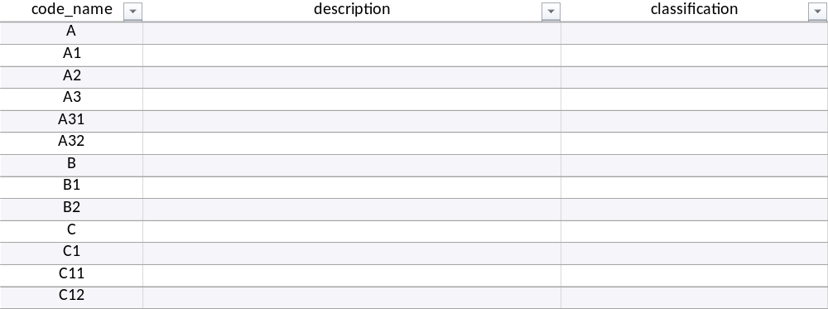
Additional information on products, machines, and other can be set in separated sheets that are connected to the BOM and BOL tables
How many equal cells are installed in parallel in the factory
To which shift schedule the cell is associated
Additional information on work cells
Additional information products and components

Slide 11
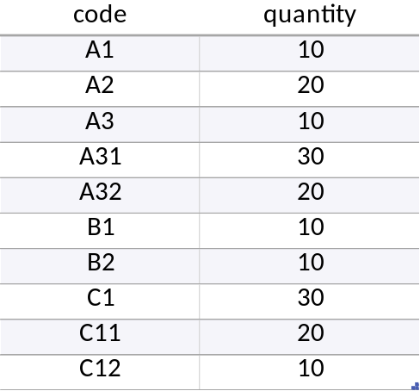
At time zero, when the simulation starts, the warehouse may already store some components that shall not be produced again
To specify the number of components available at the start up of the simulation there is a table that includes the name of the component and the quantity in stock
Which code is already available in the warehouse at the beginning of the simulation
How many items for each specific code are available in warehouse

Slide 12
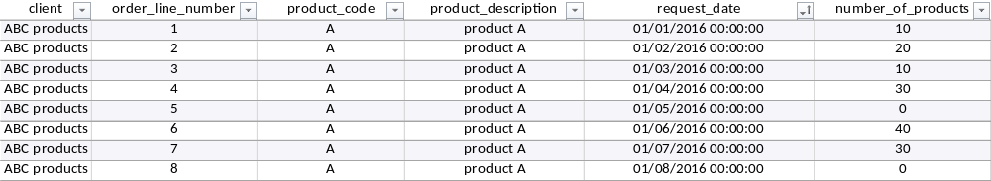
The production schedule tells when the production shall start for each order – the delivery date is generated through the simulation
Usually a production schedule is represented with a table of number of units per month as the one below
To make the mode even more flexible, the production schedule is represented in terms of orders, each row in the database is a specific order that can occur at any date or hour
Product ordered
Production start date planned
Production quantity planned
The production schedule table includes only the schedule for final products, the schedule for intermediated components is determined automatically by the model
The actual delivery date of finished products is among the outputs of the model (such approach has been selected for practicality reasons, but can be changed)

Slide 13
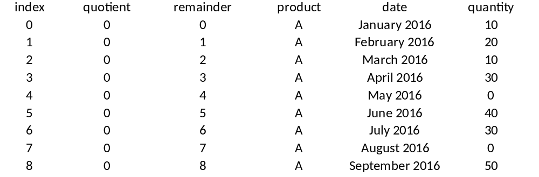
Converting the typical table for a production schedule in a sequence of orders format can be easily done within excel
Usually a production schedule is represented with a table of number of units per month as the one below
An index from 0 to the number of cells in the input table minus 1
=QUOTIENT(B15,12)
=MOD(B15,12)
=OFFSET($B$5,C15,0)
=OFFSET($C$4,0,D15)
=OFFSET($C$5,C15,D15)

Slide 14
Agenda
  The need for a factory simulation model
  Model description and illustrative example
    Inputs
    Outputs
  How the model functions under the hood
  Model infrastructure and scalability to other applications
  How to make it function on your pc (installation)

Slide 15
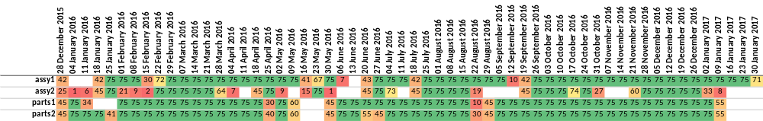
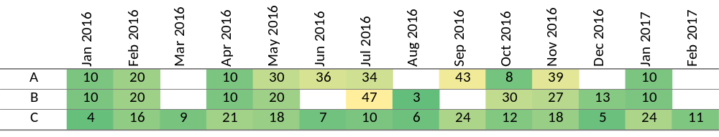
The output of the model is a table listing all production events, which can be further analysed, for instance through pivoting
A table is generated that lists all production events and the key information for each event: when the event occurred, which product and order generated the activity, which specific code is worked, which activity is performed, on which work cell, how many people are involved, what is the lead time in case of external activities, and what is the worked time
time
product
order
code
activity
work
cell
crew
lead
time
worked
time
From such table a series of pivot can be executed in excel to answer specific questions
The pivots can be also implemented within the Python environment; this step has been left out to keep the model as basic as possible and focused on the core algorithm
Output example 1: machine hours per week and bottleneck identification
Output example 2: resulting delivery dates

Slide 16
Bottlenecks location can be identified easily by plotting the weekly hours utilized for each cell
The table reports the hours used for each cell, we observe that all cells are used up to the maximum capacity of hours per week; thus in this specific example the factory is balanced

Slide 17
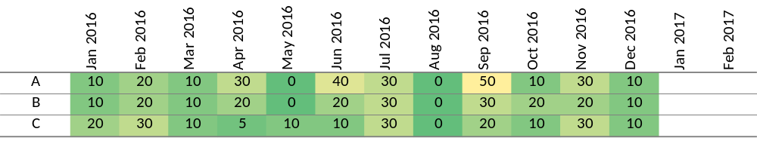
The production lead time and the delivery dates can be assessed to understand whether the factory has enough capacity
Production start
Ready for delivery

Slide 18
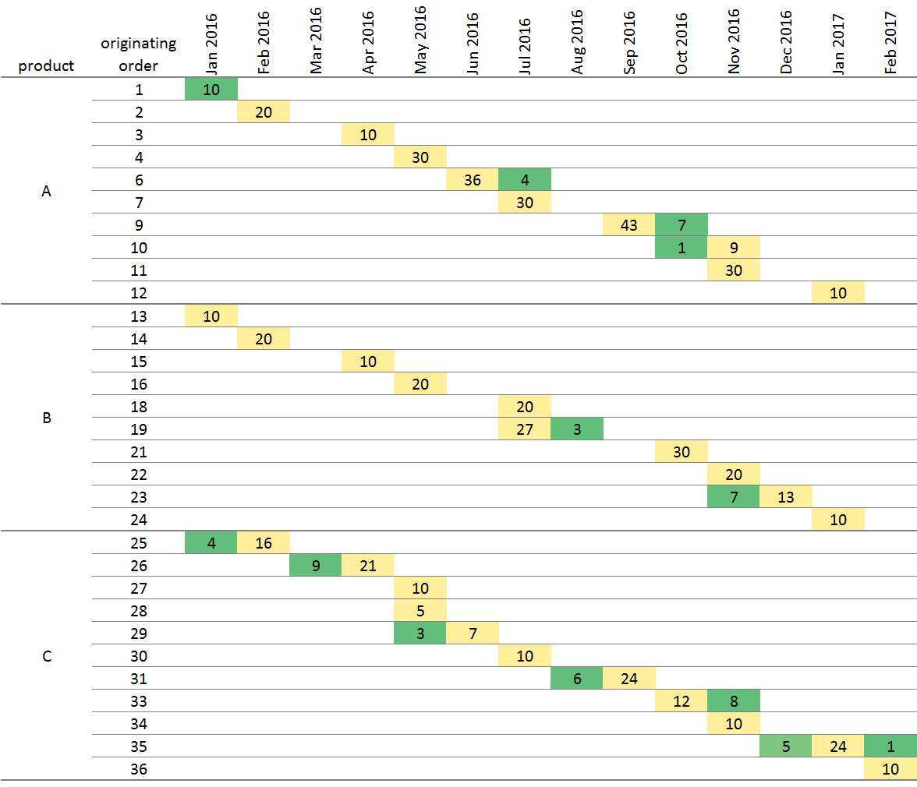
Also observing the delivery date for each order it can be understood whether the factory capacity is sufficient
The table shows when the production orders are ready to be shipped in terms of number of products per month
The output database is actually more precise as it includes the exact date for each single item

Slide 19
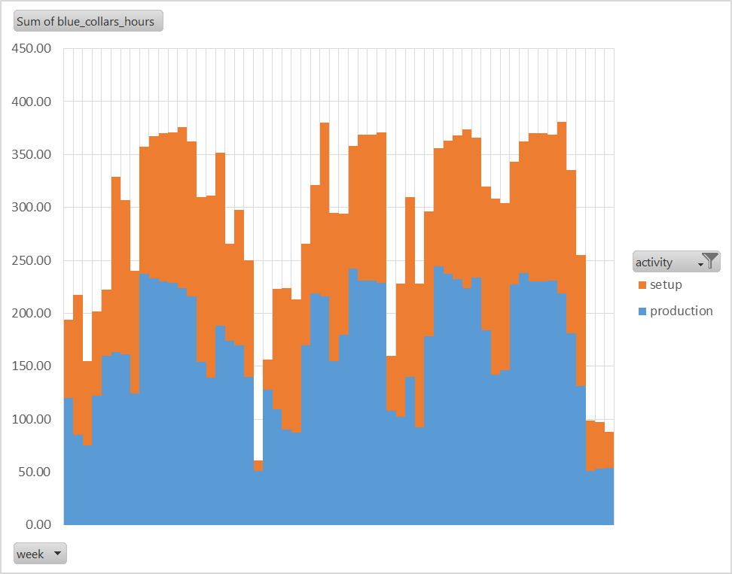
Total labour hours simulated per week is an information that can be used to better plan hiring and define line balance
This type of outputs can be generated for the entire factory, or for each specific line

Slide 20
Agenda
  The need for a factory simulation model
  Model description and illustrative example
  How the model functions under the hood
  Model infrastructure and scalability to other applications
  How to make it function on your pc (installation)

Slide 21


The simulation model has been implemented following a relatively simple and visual process which can be adapted to different needs
  The following pages illustrates from an “object oriented” viewpoint the process that has been coded in software to implement the factory simulation
  The selected process is one among many possible choices, it can be changed easily by modifying the simulation code if a different process can better represent the problem at hand
  The current implementation is proposed with three key aims:
    Provide a tool that is effective and that can be applied on real assignments
    Make the basic tool as simple as possible to facilitate the understanding of the underlying technology and methodology
    Provide an example of what can be done with the framework by working on the software code which is released open source
  Some live “objects” are instantiated in software, and are listed as follows:
queues
    queues
    blue collars
    work cells
    bill of materials
    warehouse
    empty production boxes
    filled production boxes

Slide 22
The simulation is initiated creating the objects that will last for the entire duration and running the time-line from start to end
  The time is run from the initial time to the end time (such dates are in the “shifts” sheet)
  The work stations listed in the “work_cells” sheet are created, waiting for an incoming queue of codes to be produced
  The number of blue collars from the “shifts” worksheet is put in waiting, to be called when products, components, or subcomponents will need to be produced
time
Work cells
Codes queue
Products to be produced
Blue collars
Elements that last for the entire simulation are initiated at time zero

Slide 23
When a production of a final product is started, the bill of material is recursively looked up to schedule the production of components
  Scanning the “production_start” worksheet, at the time when a product is asked for production a cascade of events are executed:
  An “empty production box” is generated to trigger the production of the code
  The “bom” sheet is scanned to identify the required components
    if some components for the code to be produced are not available, then the production box is temporarily held apart
    and for each missing component, an upstream production box is generated recursively
time
Empty production boxes which are later used in the input queue for production work cells
1
The bill of materials is read recursively to create the tree of needed production boxes (for product, components, and subcomponents)
11
121
12
122

Slide 24
Production box objects are used to signal the need for a product, which can trigger production, purchasing, or warehouse withdraw
  In the implemented simulation scheme, empty production boxes are analogues to kanban cards, representing components, subcomponents, or products to be produced, purchased, or withdrawn from the warehouse
  Each empty production box can trigger three different operations: a withdrawn from the warehouse (if the code is in the warehouse), a purchasing (if the code has to be purchased), or a production activity (if the code needs to be produced and all subcomponents are available for the production box
Warehouse
zero lead time
122
Procurement office
122
production box
lead time
Production box with finished code
queuing time
production time

Slide 25
The components and subcomponents to be produced require time from work station and blue collars
  If the component does not require subcomponents, or all the subcomponents are available in the warehouse, the production box is put in the incoming queue of the work cell that is assigned to the production code (in case of purchases, the assigned “work cell” is actually the procurement function, which is effectively modelled as a work cell with a lead time for the acquisition)
  When a work cell finds a production box in the incoming queue, the work cell calls the required blue collars, waits in case the blue collars are temporarily not available, and starts three subsequent processes: setup, production, and lead time wait for external purchases
  The times for setup, production, and external lead time are taken form the “bol” worksheet
time
queue
Work station and blue collars working on the code
queuing time
production time
122
122
Empty production box
Production box with finished code

Slide 26
Components are produced trough an inverse order in respect to the bom listing – from subcomponents to assemblies
  The actual production of codes is executed in the reverse order with respect to the generation of production boxes
  Each production box is put in queue for production when all needed components became available
  During the simulation, relevant events are stored in a log table, which will be exported in excel as the output from the simulation
time
to be produced
completed
to be produced
completed
11
11
1
1
to be produced
completed
Production box 1 for the final product is put in waiting queue when all components became available
121
121
12
12
122
122
Production box 122 is put in waiting queue immediately because it does not require components

Slide 27
Agenda
  The need for a factory simulation model
  Model description and illustrative example
  How the model functions under the hood
  Model infrastructure and scalability to other applications
  How to make it function on your pc (installation)

Slide 28
The model is already quite flexible, and can be easily extended
The model is already quite flexible
  The current model can answer many questions, for instance those related to the feasibility of a production plan:
    Are there bottlenecks that obstacles the production plan? Is the staffing adequate, or is it overestimated, or underestimated? Are the delivery dates in line with expectations or there is a need for expedite actions? Etc.
  The model is applicable to seasonal production systems, the simulation works also if the system is not in stable production
  It is applicable to variable key inputs as the number of shifts per day for each specific machine or the available blue collars to work
And can be further extended
  A learning curve parameter can be easily implemented for each code (component or product) having the working time reduced every time the code is produced
  The total production cost can be computed for each item including the information on purchase cost (which can depend on purchase time and quantity)
  Random disturbances can be easily modelled to verify the robustness of the production system; etc.
The underlying language employed is quite powerful, and the know-how acquired can be employed to build other models with ease to solve complex business requests

Slide 29
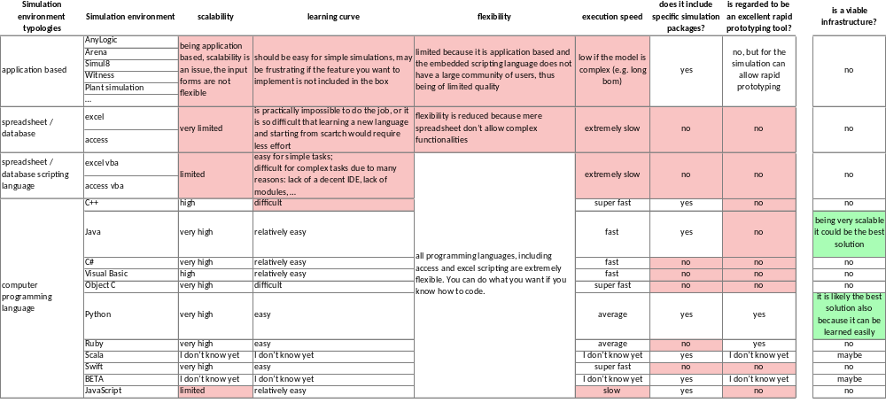
The model has been designed starting from fundamental architectural choices
Considering all needs (mostly: flexibility, easiness to learn and scalability) only two solutions can be considered viable: Java or Python; Scala and BETA may have been viable solutions, but the community supporting such languages are for sure smaller than that of Java or Python
Selection matrix (in red are highlighted the reasons for which possible solutions are rejected)

Slide 30
Many articles on the web explain how useful is Python for the business and scientific worlds
Accelerating Time to Value, Connecting Dots in the Data, Empowering Everyone
“Python is a powerful, flexible, open-source language that is easy to learn, easy to use, and has powerful libraries for data manipulation and analysis. Its simple syntax is very accessible to programming novices, and will look familiar to anyone with experience in Matlab, C/C++, Java, or Visual Basic. Python has a unique combination of being both a capable general-purpose programming language as well as being easy to use for analytical and quantitative computing.
For over a decade, Python has been used in scientific computing and highly quantitative domains such as finance, oil and gas, physics, and signal processing. It has been used to improve Space Shuttle mission design, process images from the Hubble Space Telescope, and was instrumental in orchestrating the physics experiments which led to the discovery of the Higgs Boson (the so-called "God particle").
…
Python is easy for analysts to learn and use, but powerful enough to tackle even the most difficult problems in virtually any domain. It integrates well with existing IT infrastructure, and is very platform independent. Among modern languages, its agility and the productivity of Python-based solutions is legendary. Companies of all sizes and in all areas — from the biggest investment banks to the smallest social/mobile web app startups — are using Python to run their business and manage their data.”
https://www.continuum.io/content/why-python

Slide 31


Python infrastructure can be used, complementary to Excel, to work with large dataset and implement complex algorithms
  Many additional problems can be solved applying the same methodology and infrastructure:
    Simulating service environments as hospitals
    Simulating logistic networks
    Simulating transportation systems
    Working and manipulating big data
    And more …
Reference to the Simpy home page to get an understanding on the simulation potentials
Reference to the SciPy home page to get an understanding on the big data analysis potentials

Slide 32
Agenda
  The need for a factory simulation model
  Model description and illustrative example
  How the model functions under the hood
  Model infrastructure and scalability to other applications
  How to make it function on your pc (installation)

Slide 33


Installing the software is easy and has virtually zero impact on the hosting computer
Download and install Anaconda form Continuum Analytics; it includes Python and almost all scientific packages
1
https://www.continuum.io/
Install SimPy from the PIP interface; it includes the module to implement discrete event simulations with ease
https://simpy.readthedocs.org/en/latest/simpy_intro/installation.html
2
Download and install PyCharm; it is a well structured and easy to use integrated development environment
3
https://www.jetbrains.com/pycharm/

Slide 34



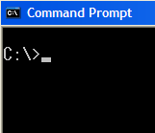
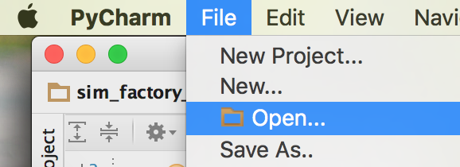
After installing Anaconda and SimPy (and optionally PyCharm), you can run the program included here as an attachment
  Put in the same folder the code file and the excel input file provided as attachments to this document
  An output folder will be generated which will include two files
    A copy of the input file for future reference, as the original input file may be changed for what if analyses
    The output spreadsheet to be further analysed and pivoted
  sim_factory_inputs.xlsx
  \folder
  sim_factory.py
  Run the python script from the command line
  C:\folder> python sim_factory.py
  Alternatively, open the python file from PyCharm (where it is easier to read and make changes to the script) and execute the script from there
  \folder\output

